Slide 1

Passerelles numériques
A Gateway for Life
Model & Migration

Slide 2
Outline
Model
Migration
Factory
Seed
Tinker

Slide 3
Model
Post model
Post table migration

Slide 4
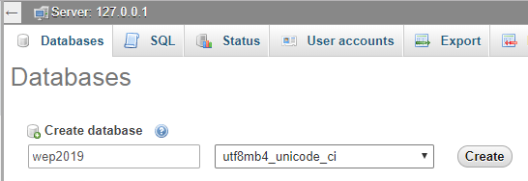
Create and connect to database
Create clean database
Ex: wep2019

Slide 5
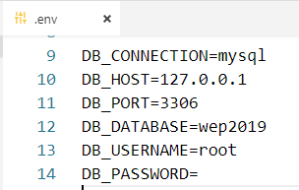
Create and connect to database
Open .env file. Set database, user name and password

Slide 6

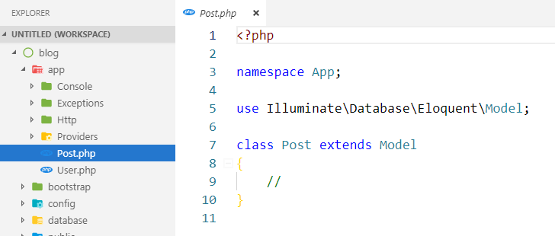
Create model
Create Post model: php artisan make:model Post

Slide 7
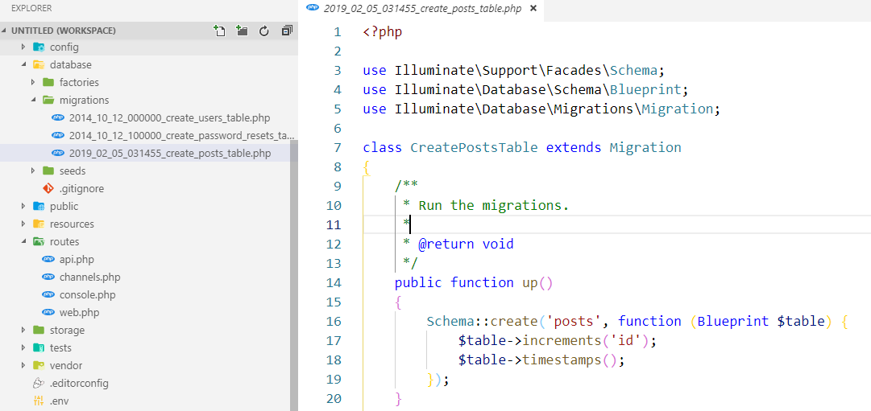
Create migration
Create posts migration: php artisan make:migration create_posts_table

Slide 8

Create model
Create Post model: php artisan make:model Post –m
-m means create model also migration table

Slide 9
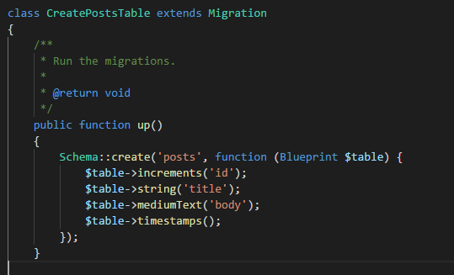
Add more fields to migration table before doing migrate command

Slide 10
Run the migrate command
Run the migrate command to create table into database
php artisan migrate:fresh

Slide 11
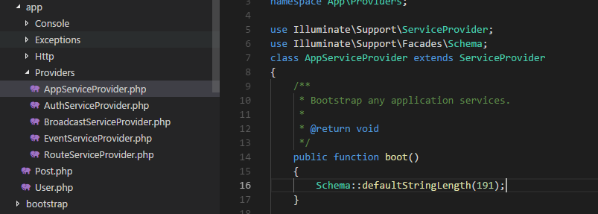
Fix the problem

Slide 12
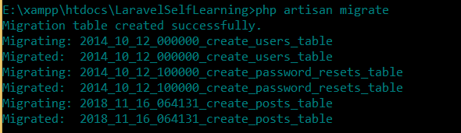
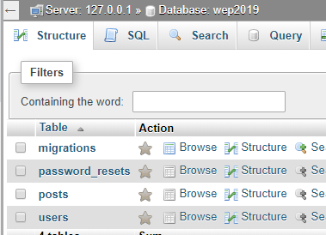
Run migrate command
php artisan migrate:fresh

Slide 13
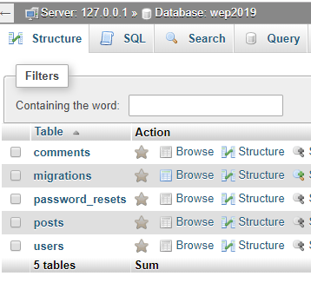
Activity#1:15mn
Try to create Comment model and also the migration for comments table
id, text
Then run the migrate command to add the comments table into the database

Slide 14
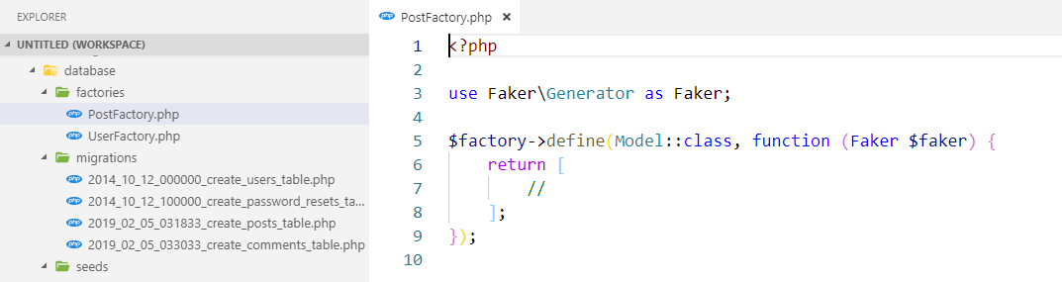
Insert some fake data
Create factory

Slide 15
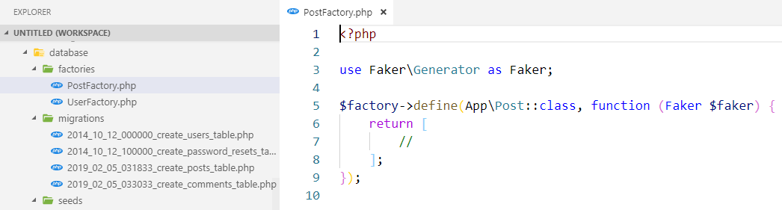
Insert some fake data
Create factory

Slide 16
factory
Factory is a class to create instances of a given Model class

Slide 17
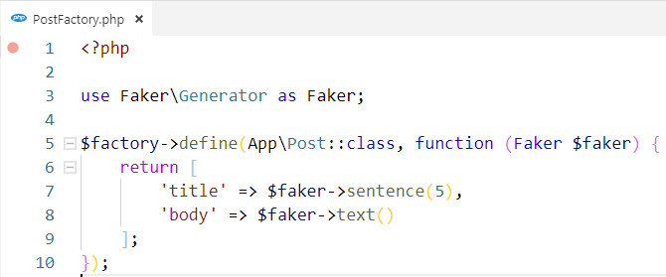
Create fake data in factory
https://github.com/fzaninotto/Faker

Slide 18
Seeder
Class to insert test data into tables in database

Slide 19
Create seeder
php artisan make:seeder NamesTableSeeder

Slide 20
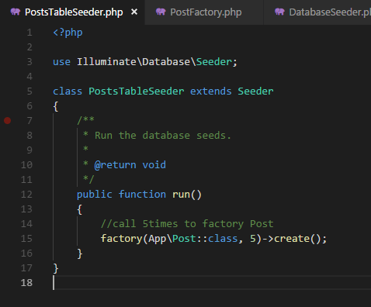
Using model factory

Slide 21
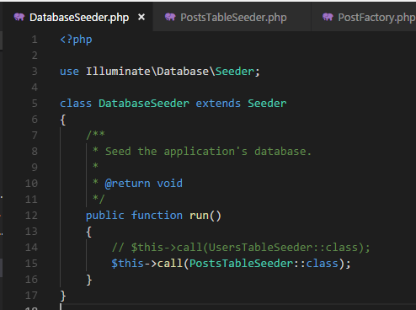
Then call PostsTableSeeder in DatabaseSeeder

Slide 22
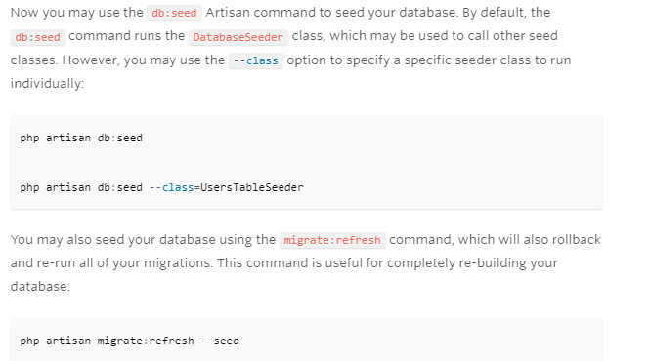

Then run your seed

Slide 23
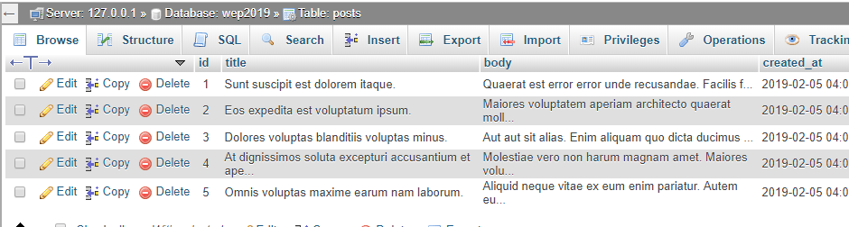

Slide 24
Activity#2:15mn
Insert 10 fake data into comments table by using factory and seed

Slide 25
Test with our posts
Tinker: tinker console allows you to interact with your Laravel application from the command line in an interactive shell
https://laravel.com/docs/5.7/artisan#tinker
php artisan tinker
Notes:
https://www.kodementor.com/how-to-use-tinker-in-laravel-application/

Slide 26
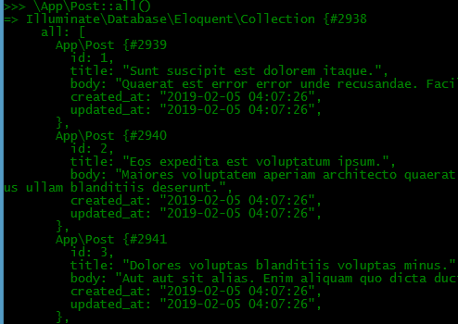
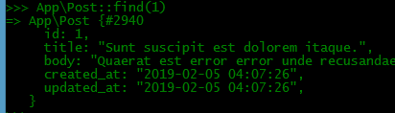
Test with our posts
Notes:
https://www.kodementor.com/how-to-use-tinker-in-laravel-application/
https://laravel.com/docs/5.7/eloquent

Slide 27
Activity#3:15mn
Try to play around with tinker with your comments table
Get all comments
Get the last comment
Notes:
//$links = Link::all();
//return $links->last();
//return Link::latest()->first(); //orderby latest timestamp created_at
return Link::latest('created_at')->first(); //orderby specific field like created_at

Slide 28
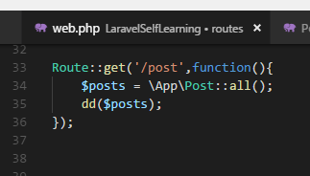
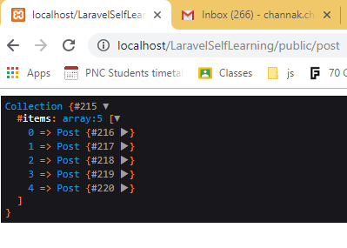
Test with our posts

Slide 29
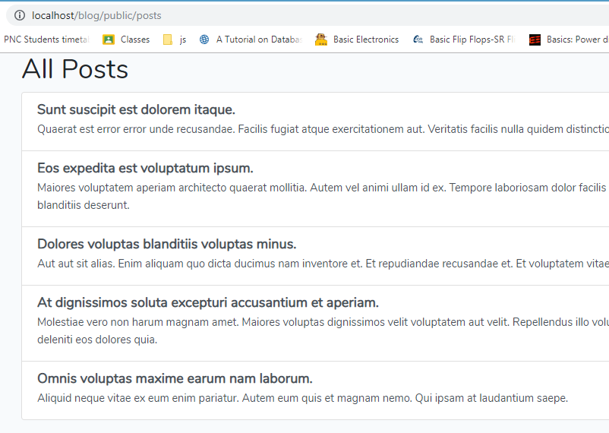
Activity#4:15mn
Display all posts in the view
Notes:
@extends('layouts.app')
@section('content')
<div class="container">
<h1>All Posts</h1>
<div class="list-group">
@foreach ($posts as $key => $value)
<a href="#" class="list-group-item list-group-item-action flex-column align-items-start">
<div class="d-flex w-100 justify-content-between">
<h5 class="mb-1" style="font-weight:bold">{{$value['title']}}</h5>
</div>
<p class="mb-1">{{$value['body']}}</p>
{{-- <small class="text-muted">Donec id elit non mi porta.</small> --}}
</a>
@endforeach
</div>
</div>
@endsection

Slide 30
Query Builder
https://laravel.com/docs/5.7/queries
Eloquent
https://laravel.com/docs/5.7/eloquent
Faker
https://github.com/fzaninotto/Faker

Slide 31

Question?
Google.com

